Slide 1
Secure Electronic Transaction (SET) Protocol

Slide 2
What is SET?
Secure Electronic Transaction (SET) is a system and electronic protocol to ensure the integrity and security of transactions conducted over the internet.

Slide 3
What is SET?
The primary goal of SET is to protect credit/debit card transactions as they take place online.
It provides a secure and confidential transaction environment for everyone involved in the e-commerce transaction, including the customer and merchant. It also authenticates users with the help of digital certificates.
SET is relatively new standard. It was first used in 1996 and was proposed by VISA and MASTERCARD.

Slide 4
Requirements in SET :
Provide confidentiality of ordering and payment information.
Provide authentication that a cardholder is a legitimate user of a credit card account.
Ensure the integrity of all transmitted data.
Provide authentication that a merchant can accept credit card transactions through its relationship with financial institutions.
It has to be resistive against message modifications i.e., no changes should be allowed in the content being transmitted.
SET also needs to provide interoperability and make use of the best security mechanisms.

Slide 5
Key features of SET :
Confidentiality of information : A credit card holder's personal & payment information is secured. The merchant never sees the credit card number; this is only provided to the issuing bank. Conventional encryption using DES is used to provide confidentiality.
Integrity of data : Payment information sent from cardholders to merchants include order information, personal information and payment instructions. SET guarantees that these message contents are not altered in transit. RSA digital signatures, using SHA-1 hash codecs, provides message integrity.

Slide 6
Key features of SET :
Cardholder Account Authentication : SET enables merchants that the cardholder is legitimate user of a valid card account number. SET uses X.509v3 digital certificates with RSA signatures for this purpose.
Merchant Authentication : SET enables cardholders to verify that a financial institution allowing it to accept payment cards. SET uses X.509v3 digital certificates with RSA signatures for this purpose.

Slide 7
Participants in SET :
Cardholder – customer
Issuer – customer financial institution
Merchant
Acquirer – Merchant financial
Certificate authority – Authority that follows certain standards and issues certificates(like X.509V3) to all other participants.

Slide 8
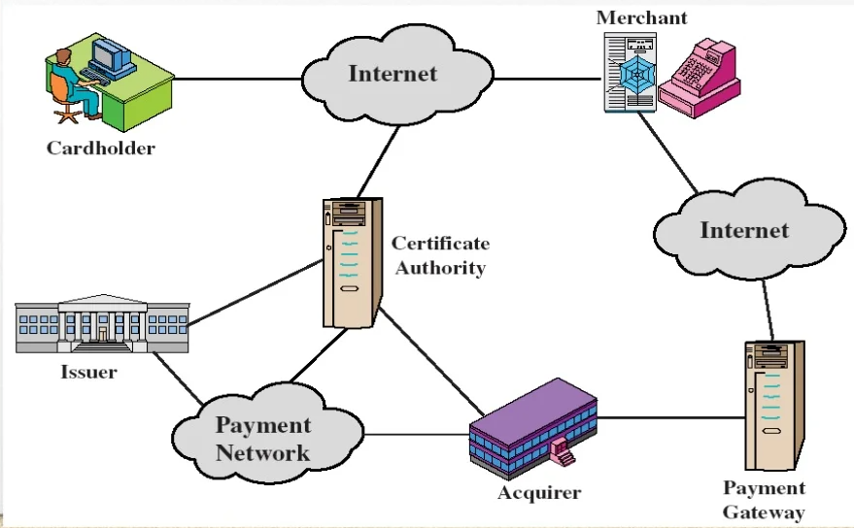
SET components and Participants :

Slide 9
Dual signature :
Concept : The dual signature is a concept introduced with SET, which aims at connecting two information pieces meant for two different receivers: Order Information (OI): Customer to Merchant Payment Information (PI): Customer to Bank
Goal : Limit information to "Need-To-Know" basis :
-Merchant does not need credit card number.
-Bank does not need details of customer order.
-Afford the customer extra protection in terms of privacy
by keeping these items separate.

Slide 10
Why Dual Signature?
Suppose that customer sends the merchant two messages:
If the merchant can capture another order information from this customer, the merchant could claim this order goes with the payment information rather than the original
-The signed order information (OI)
-The signed payment information (PI)
-In addition, the merchant passes the payment
information to the bank.

Slide 11
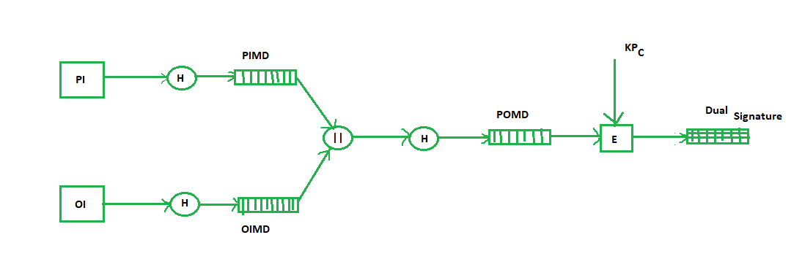
Dual signature :
PI- payment information OI- order information PIMD- Payment Information Message Digest H- Hashing OIMD- Order Information Message Digest E- public key encryption POMD- Payment Order Message Digest KPc- customer's private key
Dual signature, DS= E(KPc, [H(H(PI)||H(OI))])

Slide 12
Purchase Request Generation :
The process of purchase request generation requires three inputs:
Payment Information (PI)
Dual Signature
Order Information Message Digest (OIMD)

Slide 13
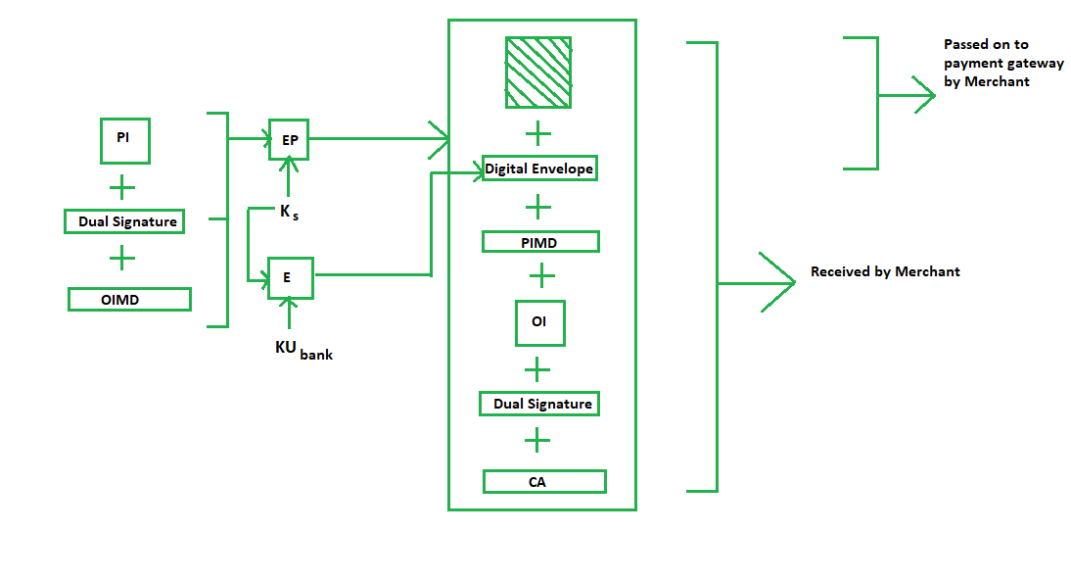
Purchase Request Generation :
EP- symmetric key encryption Ks- a temporary symmetric key KUbank- public key of bank CA- Cardholder or customer Certificate Digital Envelope = E(KUbank, Ks)

Slide 14
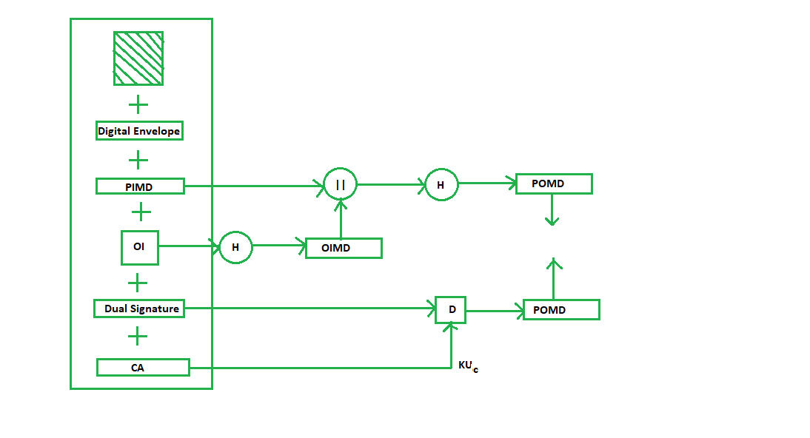
Purchase Request Validation on Merchant Side :
The Merchant verifies by comparing POMD generated through PIMD hashing with POMD generated through decryption of Dual Signature as follows:
Since we used Customer’s private key in encryption here we use KUC which is the public key of the customer or cardholder for decryption ‘D’.

Slide 15
Payment Authorization and Payment Capture :
Payment authorization as the name suggests is the authorization of payment information by the merchant which ensures payment will be received by the merchant. Payment capture is the process by which a merchant receives payment which includes again generating some request blocks to gateway and payment gateway in turn issues payment to the merchant.

Slide 16
Conclusion :
Uses 1024 bit cipher keys, making it one of the strongest encryption applications.
If we use 100 computers each using 10 MIPS, it would take 2.8 x 10^11 years to break one encrypted message.

Slide 17
Thankyou.....!

